Slide 1
ECE2810J Data Structures and Algorithms
Red-black Trees
Learning Objectives:
Know what a red-black tree is and its properties
Know how to do insertion for a red-black tree

Slide 2
Outline
Red-black Trees: Basics
Red-black Trees: Insertion

Slide 3
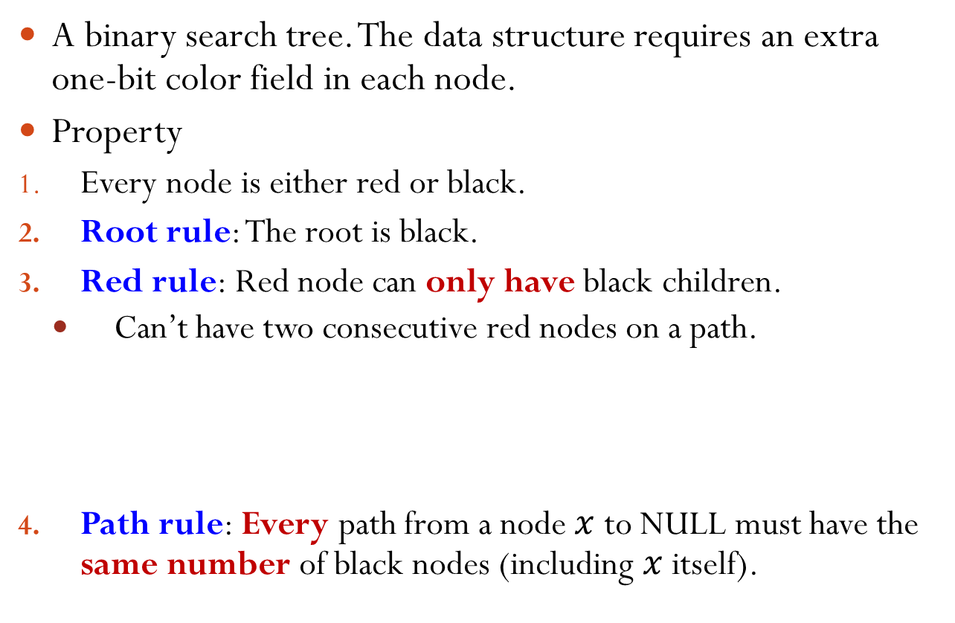
Red-Black Tree
A binary search tree. The data structure requires an extra one-bit color field in each node.
Property
Every node is either red or black.
Root rule: The root is black.
Red rule: Red node can only have black children.
Can’t have two consecutive red nodes on a path.
Path rule: Every path from a node $x$ to NULL must have the same number of black nodes (including $x$ itself).
✓
✗
✗

Slide 4
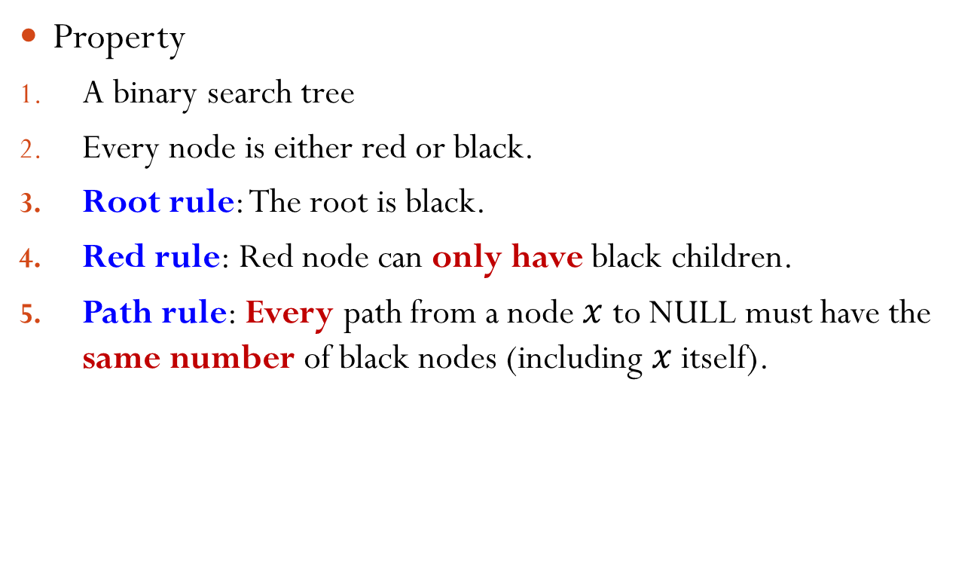
Red-Black Tree Example
Property
A binary search tree
Every node is either red or black.
Root rule: The root is black.
Red rule: Red node can only have black children.
Path rule: Every path from a node $x$ to NULL must have the same number of black nodes (including $x$ itself).
5
3
8
1
4
6
9
Notes:
The example satisfies all the rules.

Slide 5
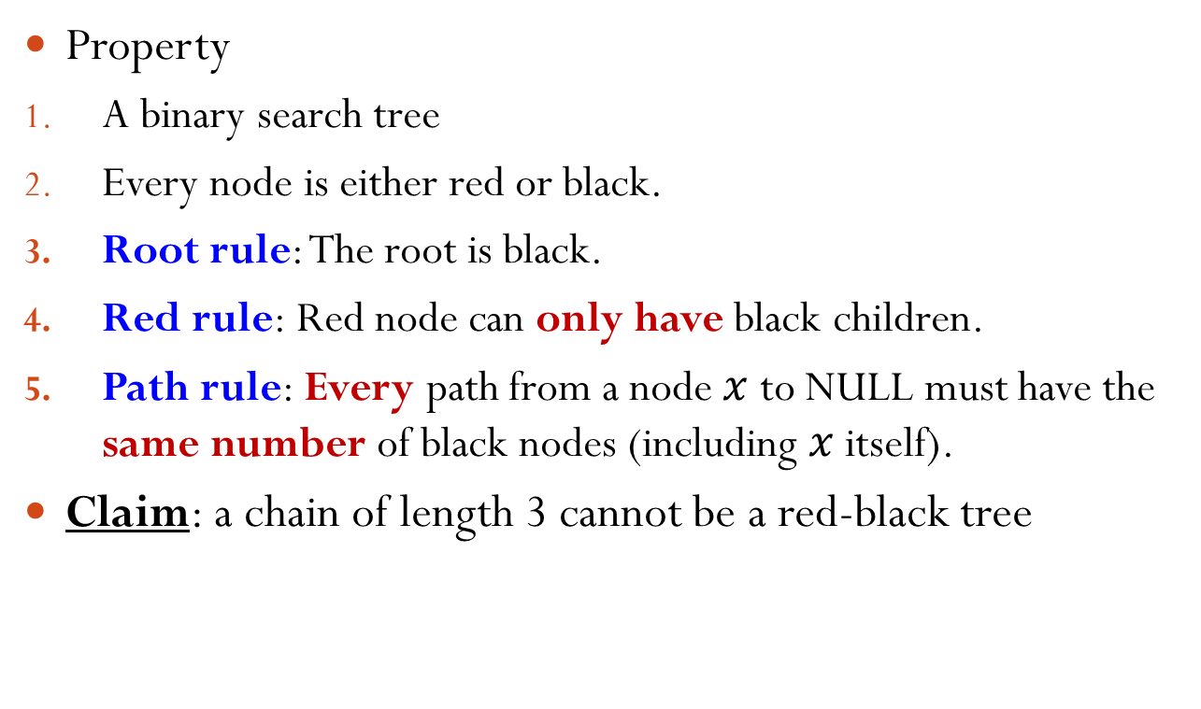
Counter Example
Property
A binary search tree
Every node is either red or black.
Root rule: The root is black.
Red rule: Red node can only have black children.
Path rule: Every path from a node $x$ to NULL must have the same number of black nodes (including $x$ itself).
Claim: a chain of length 3 cannot be a red-black tree
?
?
Notes:
The second node cannot be black; Otherwise, it violates the path rule. Thus, the second node must be red. The third node then must be black due to red rule. This eventually violates the path rule.

Slide 6

Black Height
Black height of a node $x$ is the number of black nodes on the path from $x$ to NULL, including $x$ itself.
5
2
1
3
8
1
1
1
1
4
6
0
9
0

Slide 7


Which Statements Are Correct?
A. It is possible for a red node to have a single child.
B. It is possible for a black node to have a single child.
C. It is possible for a node to have two children of different colors.
D. It is possible for a node to have two children and the node and its children are all of the same color.
Notes:
Answer: B, C, D
For C: root black, with a red and a black child. The red child has two black children.

Slide 8
Implication of the Rules
If a red node has at least one child, it must have two children and they must be black.
Why?
A red node’s child can only be black.
If has only one black child, then violate the path rule.
If a black node has only one child, that child must be a red leaf.
Why?
Can’t be black.
Must be a leaf.
5
3
8
1
4
6
Notes:
Must be a red leaf: if not black, then violate the path rule. If not a leaf, then it has children and the children must be black, which violates the path rule.

Slide 9
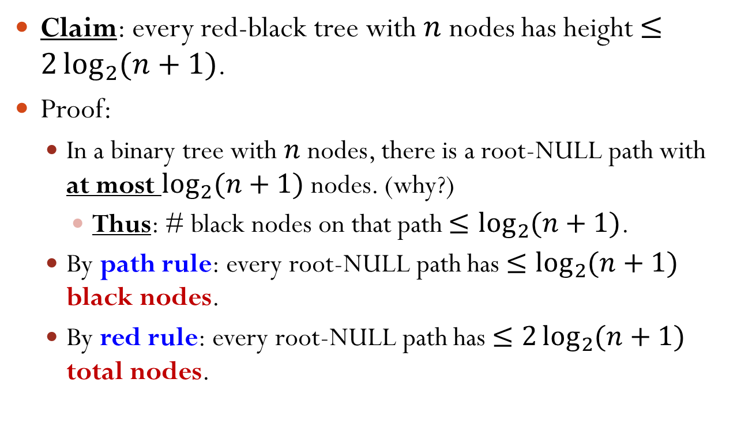
Height Guarantee
Claim: every red-black tree with $n$ nodes has height $≤2\log_{2}{(n+1)}$.
Proof:
In a binary tree with $n$ nodes, there is a root-NULL path with at most $\log_{2}{(n+1)}$ nodes. (why?)
Thus: # black nodes on that path $≤\log_{2}{(n+1)}$.
By path rule: every root-NULL path has $≤\log_{2}{(n+1)}$ black nodes.
By red rule: every root-NULL path has $≤2\log_{2}{(n+1)}$ total nodes.
Q.E.D.
Notes:
Otherwise, if every root-NULL path has more than log_2(n+1) nodes, then it at least contains a perfect binary tree of height log_2(n+1). Then, the number of nodes in the tree is larger than n.

Slide 10
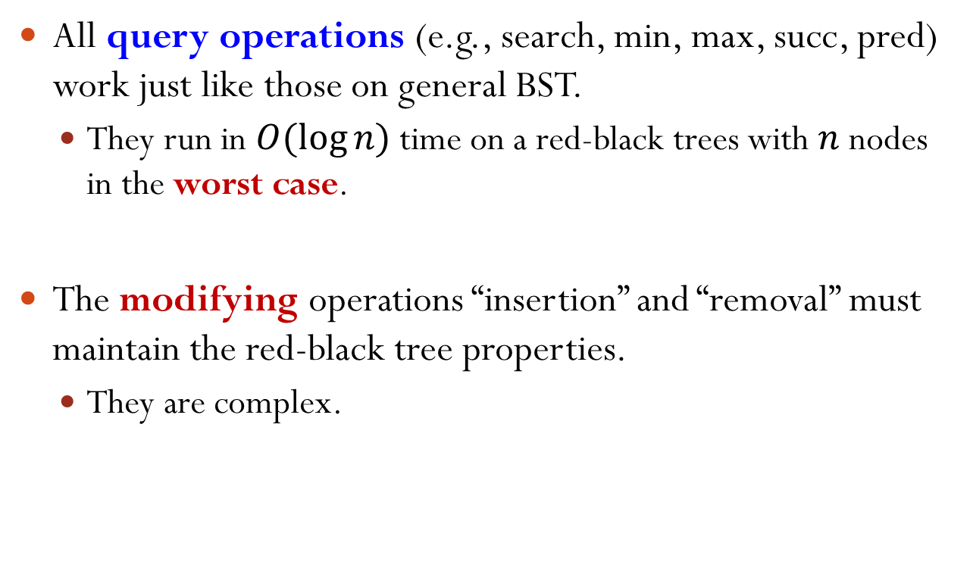
Operations on Red-Black Trees
All query operations (e.g., search, min, max, succ, pred) work just like those on general BST.
They run in $O(log⁡n)$ time on a red-black trees with $n$ nodes in the worst case.
The modifying operations “insertion” and “removal” must maintain the red-black tree properties.
They are complex.

Slide 11
Outline
Red-black Trees: Basics
Red-black Trees: Insertion

Slide 12
Insertion
5
New node is always a leaf.
However, it can’t be black!
Otherwise, violate path rule.
Therefore the new leaf must be red.
If parent is black, done (trivial case).
If parent is red, violate the red rule!
3
8
1
4
6
9
✗
7
5
3
8
8
We have to do some work…
1
4
6
9
6
9
2
✓
7
Notes:
We assume that the tree before insertion is a valid red-black tree.

Slide 13







Modification: Rotation
Maintain the binary search tree property.
Can be done in $O\left(1\right)$ time.
B
A
Right Rotation
B
A
Left Rotation
$$γ$$
$$α$$
$$β$$
$$γ$$
$$α$$
$$β$$

Slide 14
Modification: Recoloring
5
5
3
8
3
8
Recoloring
1
4
6
9
1
4
6
9
7
7

Slide 15

Insertion: Sketch
Insert $x$ as a leaf.
Color $x$ red.
Only red rule may be violated.
Move the violation up the tree by recoloring/rotation.
At some point, the violation will be fixed.

Slide 16
Violation at Leaf
Note: only red rule may be violated by inserting a (red) node as a leaf.
When violating, its parent is red and its grandparent is black.
Denote: the inserted node as “I”, its parent as “P”, its grandparent as “G”.
G
P
Q
I
Inserted
Notes:
Why parent red? Because otherwise it is not red rule violation.
Why grandparent black? Because otherwise it violates the red rule, but the tree before insertion is a valid red-black tree.

Slide 17

Which Statements Are Correct?
Suppose there is a violation at the leaf. Suppose the parent of the inserted node is “P”. Select all the correct statements.
A. P could be a non-leaf in the original tree.
B. P could have a sibling.
C. P cannot have a sibling.
D. P could have a sibling and that sibling must be a leaf node.
G
…
P
…
I
Inserted
Notes:
Answer: B & D.

Slide 18
Violation at Leaf
Note: only red rule may be violated by inserting a (red) node as a leaf.
When violating, its parent is red and its grandparent is black.
Denote: the inserted node as “I”, its parent as “P”, its grandparent as “G”.
Claim: in the old tree, “P” is a leaf, i.e., has no children.
G
P
Q
I
Inserted
Notes:
Why P is a leaf? Otherwise, P has a child, the child must be black. However, this violates the path rule.

Slide 19
Violation at Leaf
Assume: the parent “P” is the left child of the grandparent “G”.
The “right child” case is symmetric.
Denote: the right child of the grandparent to be Q.
Claim: Q is either a red leaf or a NULL.
Why?
G
P
Q
I
Inserted
Notes:
Why? Q is NULL is fine. If Q is not NULL, Q must be red (otherwise, violating path rule). If Q is red, then Q must be a leaf.

Slide 20
Violation at Leaf
Three cases:
1. Q is a red leaf. 2. Q is empty; I is P’s left child.
3. Q is empty; I is P’s right child.
G
G
P
Q
P
I
Inserted
I
Inserted
G
P
I
Inserted

Slide 21
Violation at Leaf
Case 1: Q is a red leaf.
G
G
Recoloring
P
Q
P
Q
I
Inserted
I
Inserted
May recurse, since G’s parent may be red.

Slide 22
Violation at Leaf
Case 2: Q is empty; I is P’s left child.
G
P
Right Rotation
P
I
G
I
Inserted
Recoloring
P
Done! All properties restored. (Why?)
I
G
Notes:
Recoloring: P from red to black and G from black to red

Slide 23
Violation at Leaf
Case 3: Q is empty; I is P’s right child.
G
G
Left Rotation
It’s Case 2!
P
I
I
Inserted
P
Right Rotation
I
Recoloring
I
P
G
P
G
Done! All properties restored.

Slide 24
Violation at Leaf: Summary
For Case 2 (Q is empty; I is P’s left child) and Case 3 (Q is empty; I is P’s right child), we’re done.
For Case 1 (Q is a red leaf), we may recurse.
Violation of red rule.
…
…
H
H
…
Recoloring
…
G
G
P
Q
P
Q
I
Inserted
I
Inserted

Slide 25
Violation at Internal Nodes
Caused by moving the violation up the tree.
When violating, its parent is red and its grandparent is black.
Assume: the parent “P” is the left child of the grandparent “G”. (The “right child” case is symmetric.)
Denote: the right child of the grandparent to be Q.
G
P
Q
Violation
I
Notes:
When violating, its parent is red and its grandparent is black. This is the same as the leaf case.

Slide 26
Violation at Internal Nodes
Three Cases:
Q is a red node.
Claim:
α, β, γ, δ, ε are trees with black root.
α, β, γ, δ, ε have the same black height.
G
P
Q
Violation
I
γ
δ
ε
α
β
Notes:
alpha and beta black due to recoloring in the previous step. gamma, delta, and epsilon black due to red rule in the original red-black tree.
After recoloring, I becomes red, however, it is black before, with its child being red. Thus, the black height of beta is equal to the black height of gamma. It can also be proved that the black height of alpha is the same as the black height of beta.

Slide 27
Violation at Internal Nodes
Three Cases:
2. Q is a black node; I is P’s left child.
3. Q is a black node; I is P’s right child.
Claim for Case 2 and 3:
α, β, γ, Q are trees with black root.
α, β, γ, Q have the same black height.
G
Violation
P
Q
I
γ
α
β
G
P
Q
α
I
Violation
β
γ

Slide 28
Violation at Internal Nodes
Case 1: Q is a red node.
G
G
Violation
P
Q
P
Q
Recoloring
I
γ
δ
ε
I
γ
δ
ε
α
β
α
β
May recurse, since G’s parent may be red.

Slide 29
Violation at Internal Nodes
Case 2: Q is a black node; I is P’s left child.
G
P
Violation
P
Q
Right Rotation
I
G
I
γ
α
β
γ
Q
α
β
P
Recoloring
I
G
Done! All properties restored.
α
β
γ
Q
Notes:
Recoloring: P from red to black and G from black to red.
Why choose to recoloring this way instead of making I black? Because in this case, if P red, it may still violate the red rule; if P black, it violates the path rule.

Slide 30
Violation at Internal Nodes
Case 3: Q is a black node; I is P’s right child.
G
G
P
Q
Left Rotation
I
Q
α
I
P
γ
Violation
β
γ
α
β
It’s Case 2!

Slide 31
Violation at Internal Nodes: Case 3 (cont.)
G
I
I
Q
Right Rotation
P
G
P
γ
α
β
γ
Q
α
β
I
Recoloring
P
G
γ
Q
Done! All properties restored.
α
β
Notes:
Recoloring: I from red to black and G from black to red

Slide 32
Violation at Internal Nodes: Summary
For Case 2 (Q is a black node; I is P’s left child) and Case 3 (Q is a black node; I is P’s right child), we’re done.
For Case 1 (Q is a red node), we may recurse.
Violation of red rule.
…
…
H
H
…
…
G
G
Violation
P
Q
P
Q
Recoloring
I
γ
δ
ε
I
γ
δ
ε
α
β
α
β

Slide 33
Final Step: Violation Fix at the Root
By moving the violation up the tree …
… the root may become red.
Final step: set root to be black.
All red-black tree properties are now restored.
G
G
P
Q
Recoloring Root
P
Q
I
I
γ
δ
ε
γ
δ
ε
α
β
α
β
Notes:
In the previous step, P and Q are red and G is black, so we call recoloring and this leads to the graph at the left.

Slide 34
Example
Insert 1
Insert 8
Recoloring Root
1
1
1
8

Slide 35
Example (cont.)
Insert 2
1
Case 3 at leaf
1
8
Right Rotation
2
2
8
Left Rotation
2
2
Recoloring
1
8
1
8
Notes:
Note: Case 3.
However, it is the symmetric case of what we talked about. Thus, we do right rotation first and then left rotation.

Slide 36
Example (cont.)
Case 1 at leaf
2
Insert 7
2
Recoloring
1
8
1
8
7
7
Recoloring Root
2
1
8
7

Slide 37
Example (cont.)
Insert 3
2
Case 2 at leaf
2
1
8
Right Rotation
1
7
7
3
8
3
Recoloring
2
1
7
3
8

Slide 38
Example (cont.)
Insert 6
2
Case 1 at leaf
2
1
7
1
7
Recoloring
3
8
3
8
6
6
Notes:
It is case 1, because the other child of the grandparent is not empty.

Slide 39
Example (cont.)
Insert 4
2
Case 3 at leaf
2
1
7
1
7
3
8
3
8
Right Rotation
4
6
4
6
Left Rotation
2
2
1
7
1
7
Recoloring
4
8
4
8
3
6
3
6
Notes:
Note: case 3 at leaf.
However, it is the symmetric case of what we talked about. Thus, we do right rotation first and then left rotation.

Slide 40
Example (cont.)
Insert 5
Case 3 at internal node
2
Case 1 at leaf
2
7
1
7
1
Recoloring
4
8
4
8
3
6
3
6
5
5
Notes:
Note: Case 3 at internal node, because the other child of the grandparent is black and the direction of parent to child and grandparent to parent is opposite. (In this case: node 1 is the tree Q)

Slide 41
Example (cont.)
Case 3 at internal node
2
2
1
7
1
4
4
8
Right Rotation
7
3
3
6
6
8
5
5
Left Rotation
4
4
Recoloring
2
7
2
7
1
3
6
8
1
3
6
8
5
5
Notes:
However, it is the symmetric case of what we talked about. Thus, we do right rotation first and then left rotation.

Slide 42
Runtime Complexity
Number of rotations required
For case 1, only need to recolor, no rotation.
For case 2 or 3, perform 1 or 2 rotations and terminate.
Thus: # rotations = $O(1)$.
Number of recoloring required
Worst case: $O(\log{n})$
Runtime complexity is $O(\log{n})$.

